Slide 1

微軟參訪 軟體測試與可靠度
蔡明憲 王瀅婷
吳佩穎 胡貴蓉

Slide 2
Microsoft Corporation
Microsoft established on April 4, 1975 by Paul Allen and Bill Gates
Products
Microsoft Windows
Microsoft Office
XBOX 360

Slide 3
Microsoft Taiwan Corporation
張仁炯先生(Michael J. Chang)
Director
Office and Office family Product Unit

Slide 4
Content
Cloud Computing
Software Reliability and Testing

Slide 5
Software Reliability and Testing
Production
Same Box
Example : THSR Booking System

Slide 6
Software Reliability and Testing
PM : Product Managers
SDE : Software Development Engineers
SDET : Software Development Engineers in Test

Slide 7
Software Reliability and Testing
Collaboration
Communication
Team Spirits
Technical passion
discipline

Slide 8
Visit and Observe

Slide 9
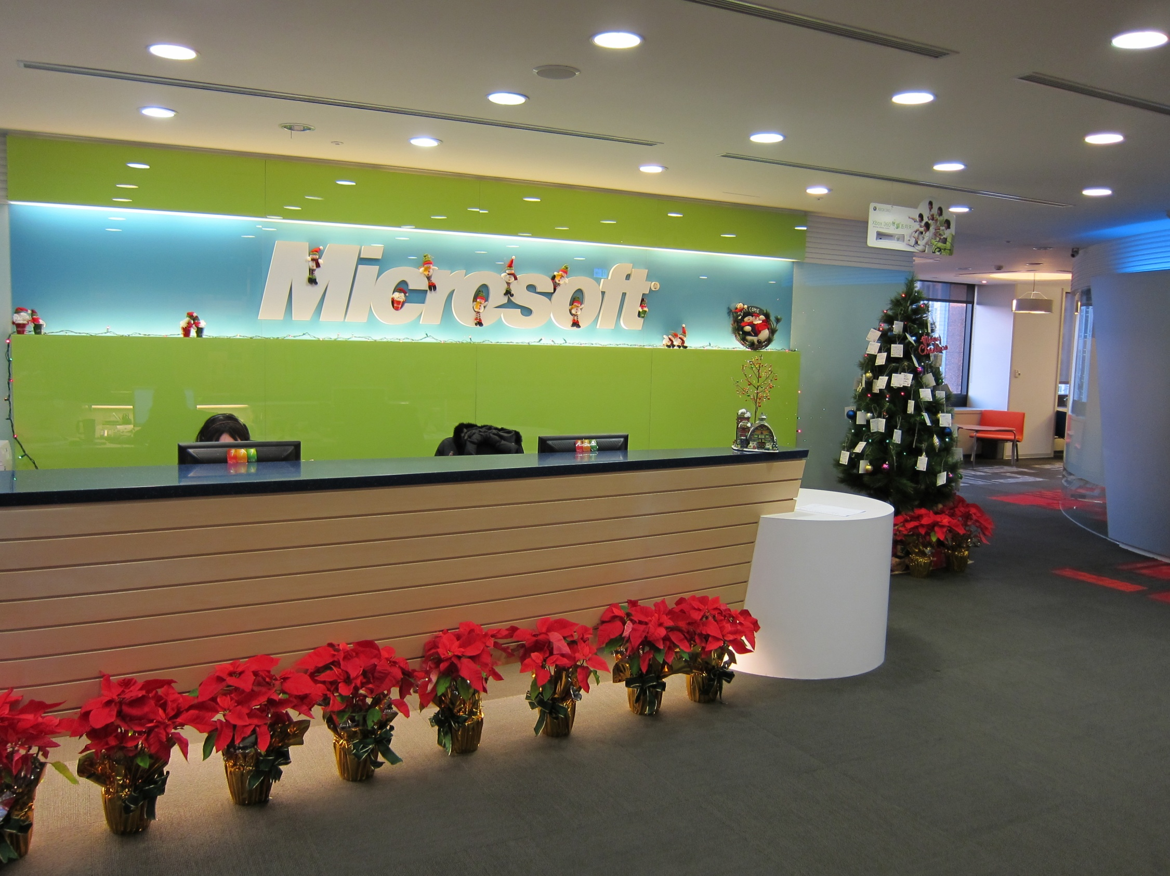

Slide 10
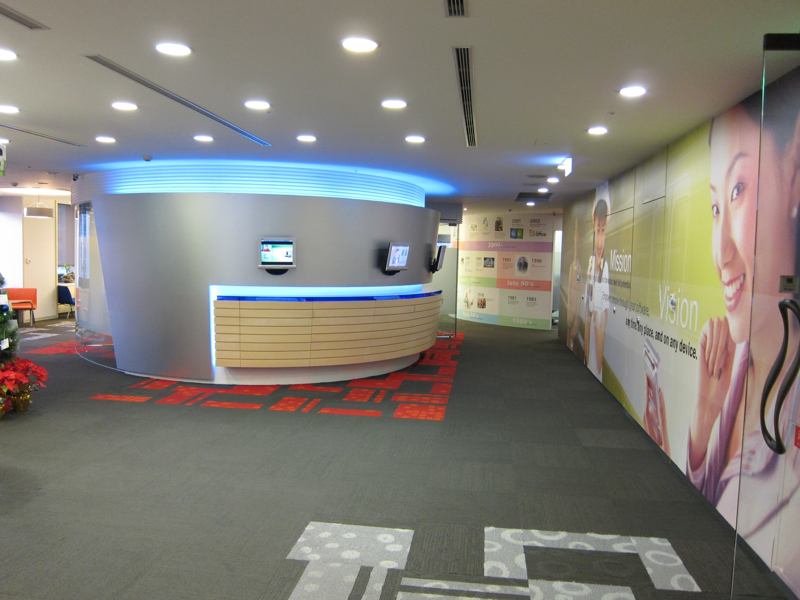

Slide 11
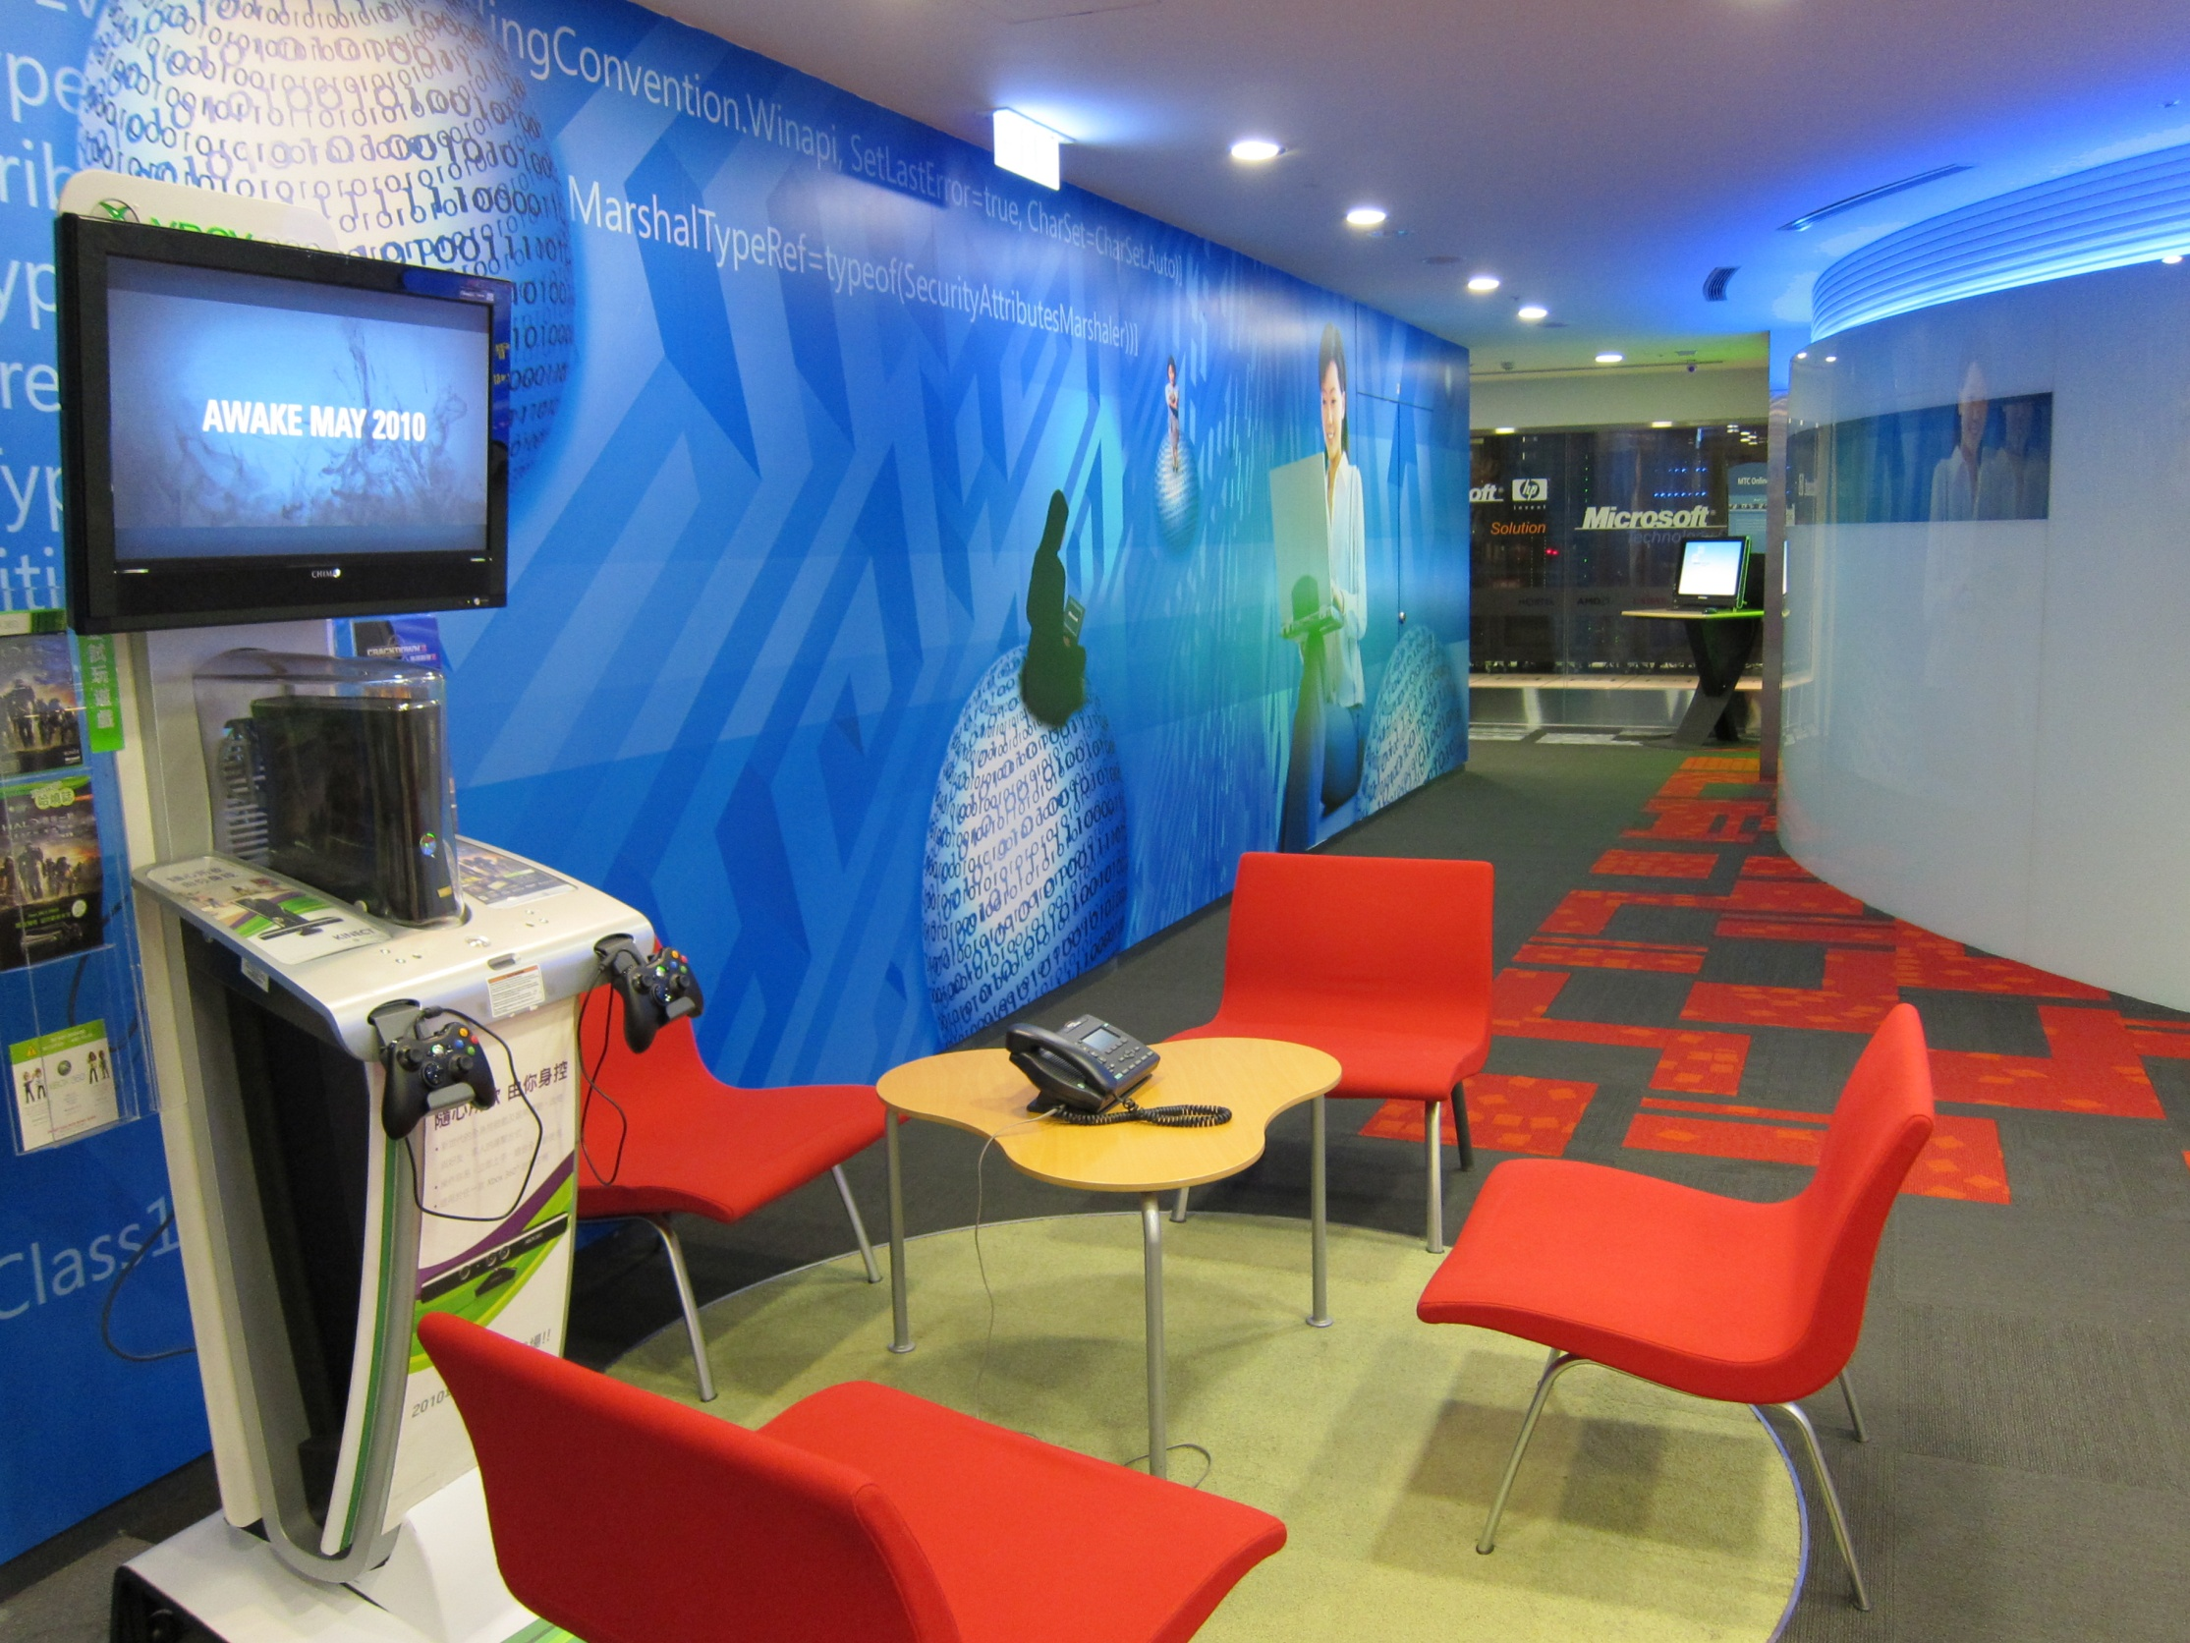

Slide 12
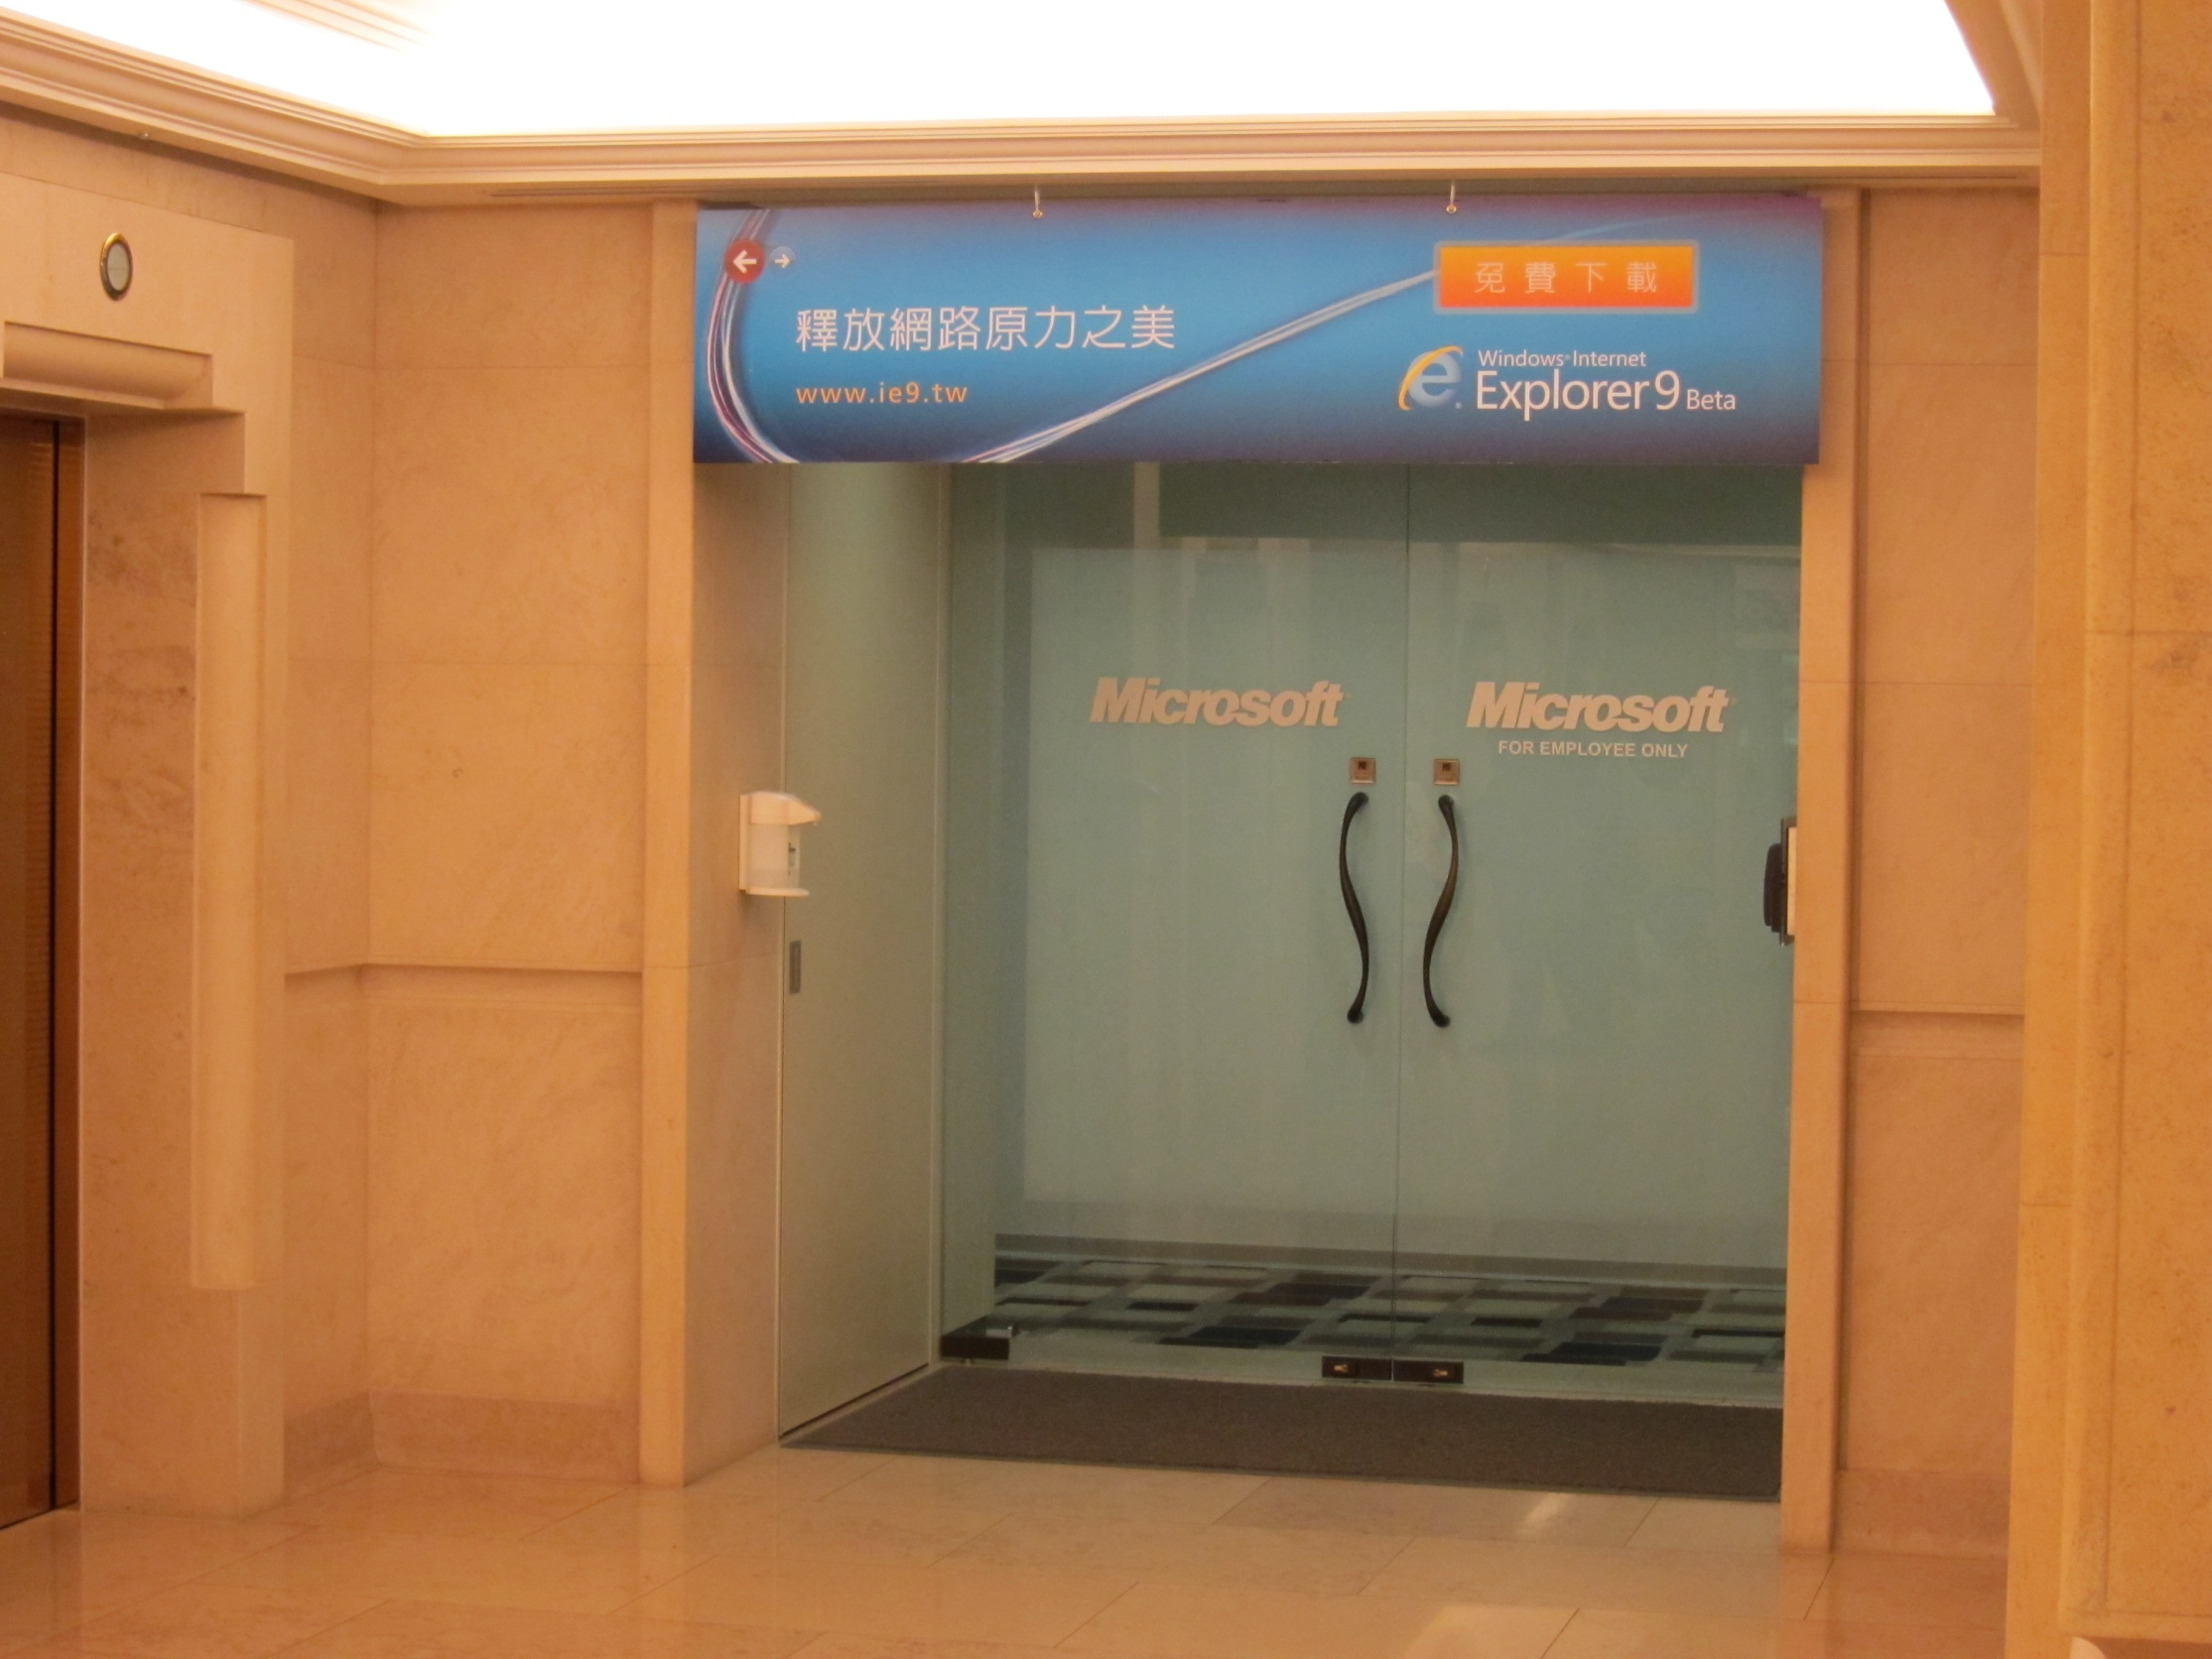

Slide 13
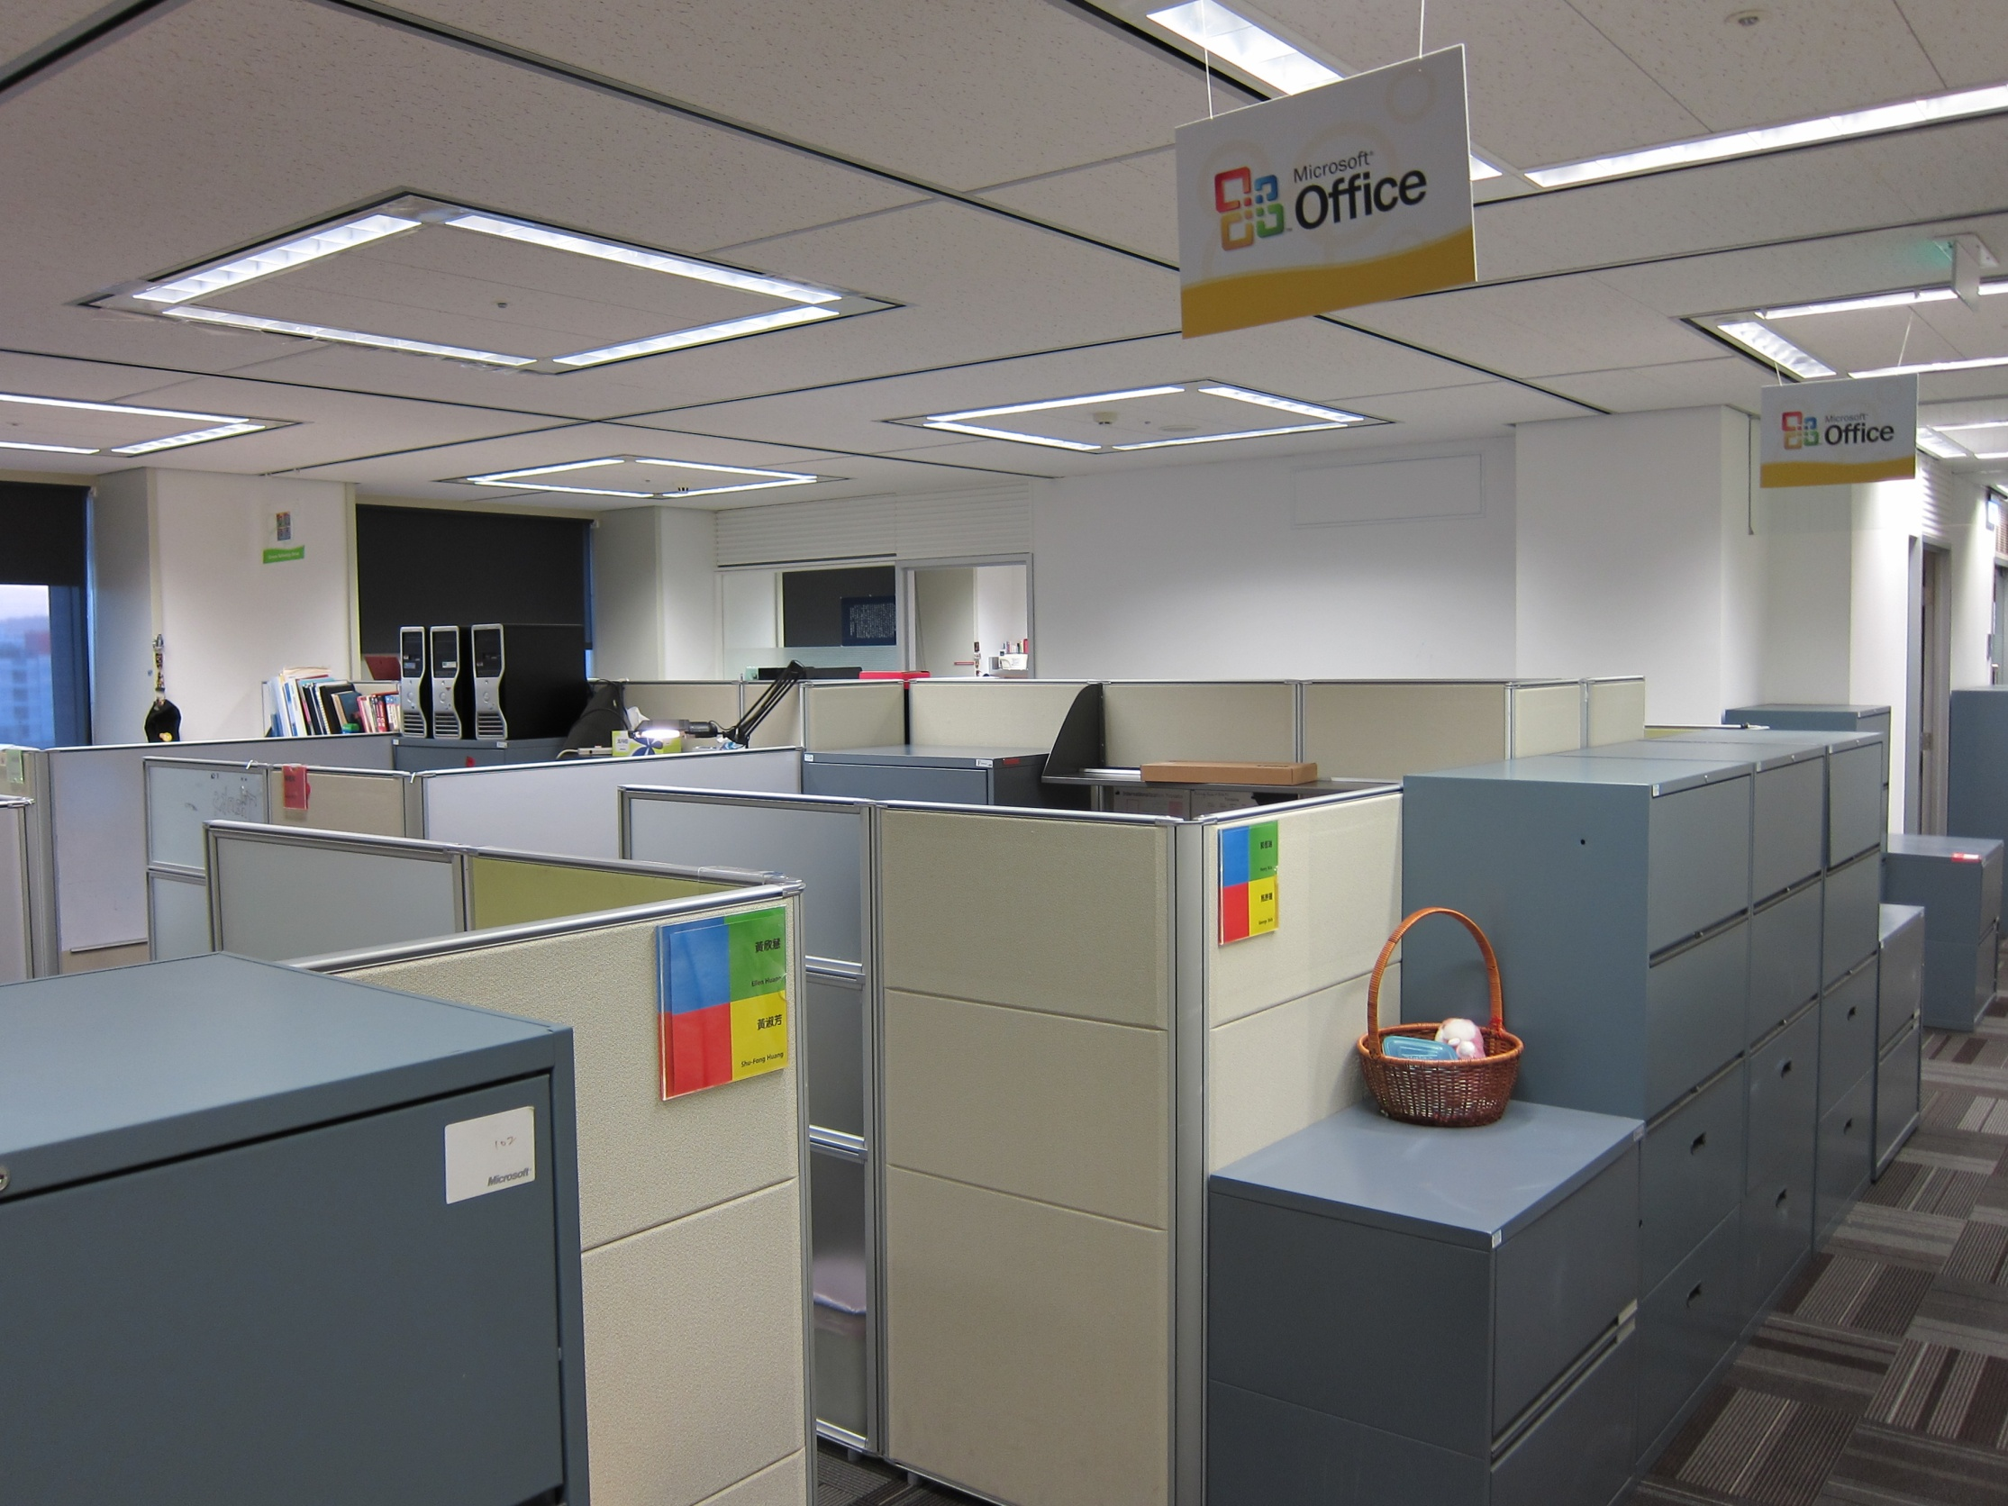

Slide 14
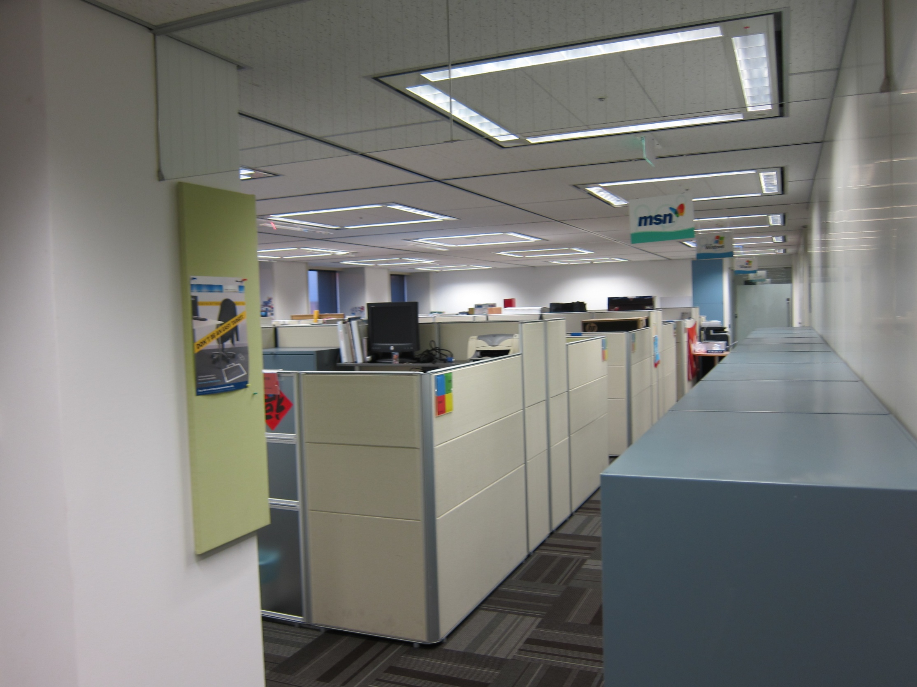

Slide 15
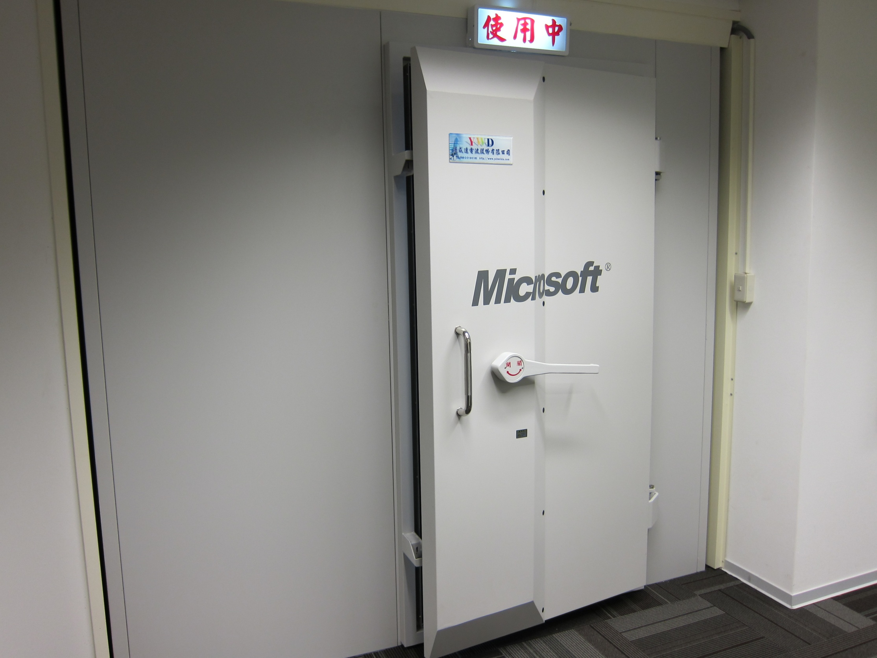

Slide 16
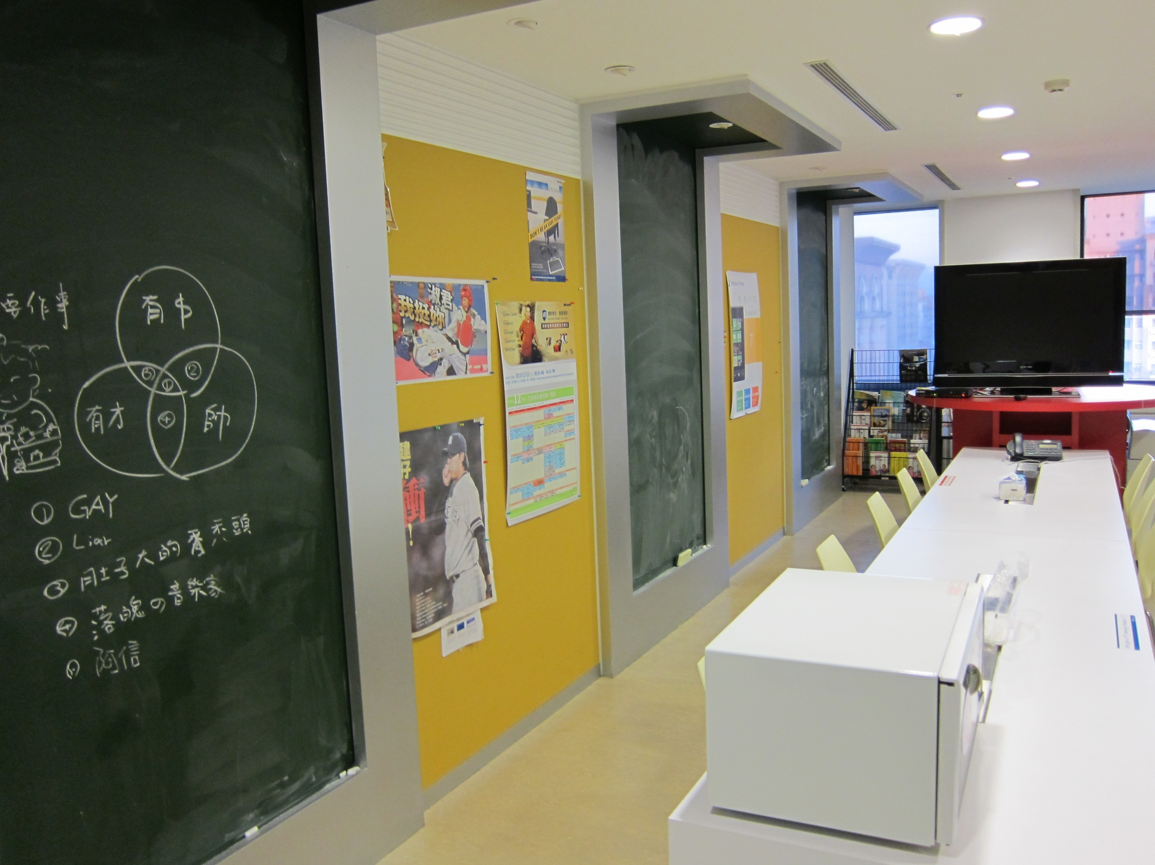

Slide 17
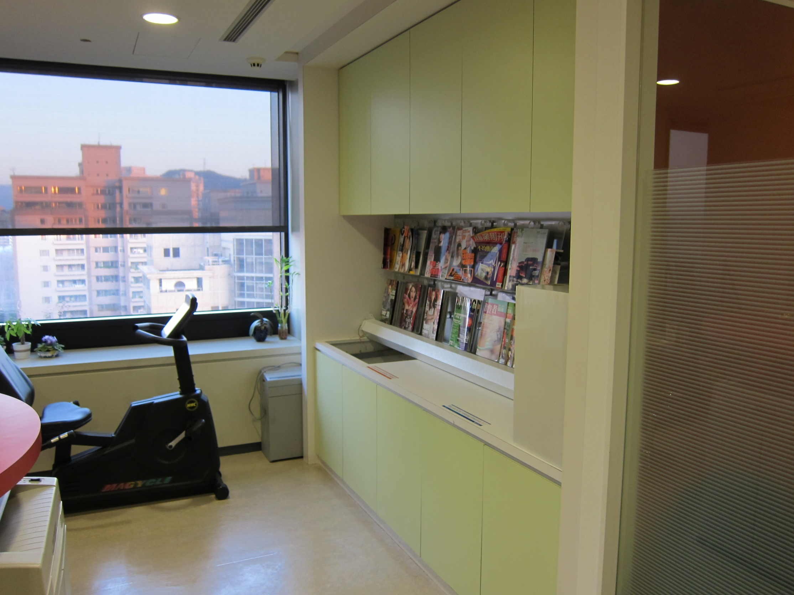

Slide 18
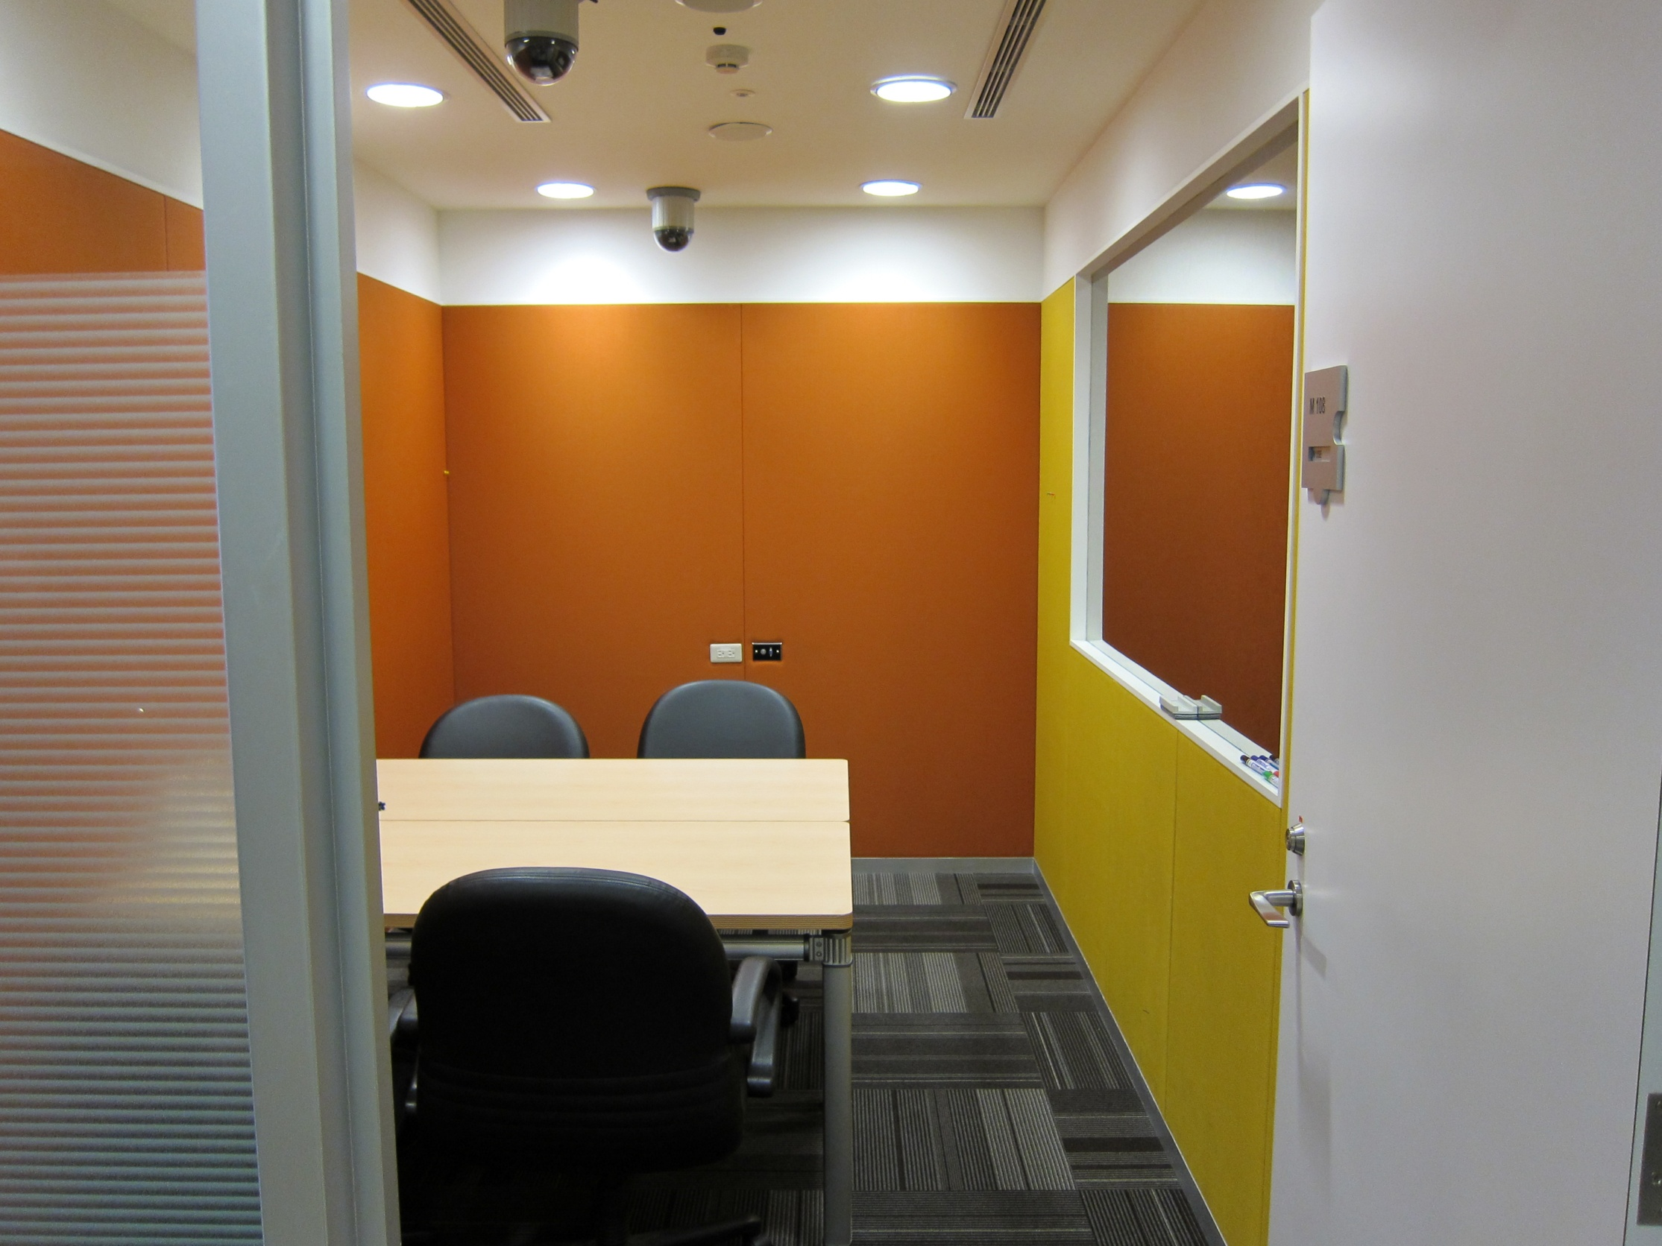

Slide 19
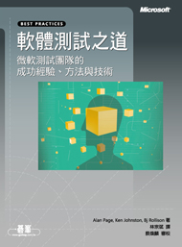
軟體測試之道
微軟測試團隊的
成功經驗、方法與技術

